Slide 1
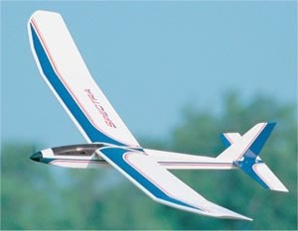
WRIGHT STUFF

Slide 2
AGENDA
INTRODUCTION
AIRCRAFT TERMINOLOGY
THEORY OF FLIGHT
GLIDER DETAILS
HINTS
EXTRA--STARTING PLANS

Slide 3
DAVE BRAUNSTEIN
ACADEMIC COORDINATOR—MESA CSULB
35 YRS CHEM. ENG. R&D
12 YRS CHEM/MESA LBUSD

Slide 4
OBJECTIVE
TO DESIGN AND CONSTRUCT A BALSAWOOD GLIDER THAT WILL HAVE THE LONGEST FLIGHT TIME WHEN LAUNCHED FROM A HAND HELD CATAPULT.

Slide 5
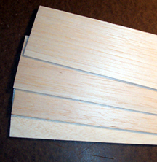
MATERIALS
BALSAWOOD.
GLUE – ANY TYPE.
MODELING CLAY.
PAINT, STICKERS, INK, AND MARKERS MAY BE USED FOR DECO OR ID.

Slide 6
RULES
NO READY MADE KITS.
GLIDER WITH CLAY BALLAST
1:1 DRAWING WITH ISOMETRIC AND PLAN VIEWS- CAD AND HAND DRAWN PERMITTED

Slide 7
RULES- (CONT’D)
NOSE HOOK FOR LAUNCHING A MUST.
CATAPAULT WILL BE PROVIDED
LAUNCH RELEASE Ht=6 ft. max
3 LAUNCHES- 2 BEST COUNTED

Slide 8
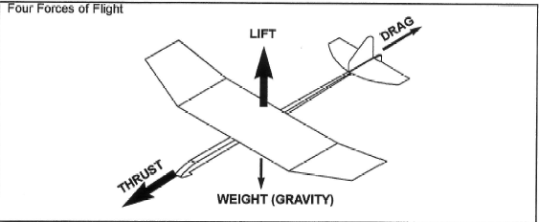
4 FORCES OF FLIGHT

Slide 9
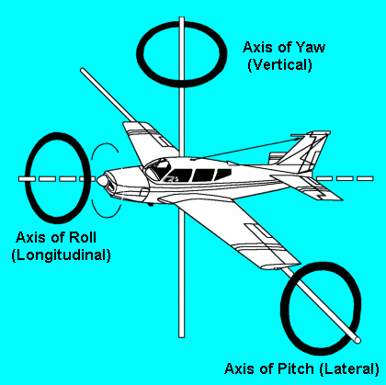
AXIS OF ROTATION

Slide 10
FLIGHT THEORY
Newton’s 3 laws of Motion
Inertia
F=ma
Action=Reaction
Bernoulli’s Law of fluid flow (1730’s)
K= ½ mv² + PV + mgh
K= ½ ρv² + P + ρgh ρ= density

Slide 11
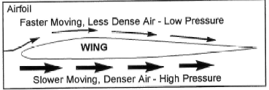
K=1/2ρv² + P + ρgh

Slide 12
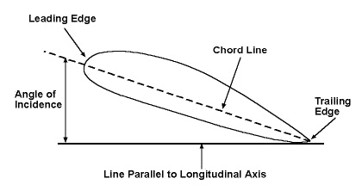
ANGLE OF INCIDENCE

Slide 13
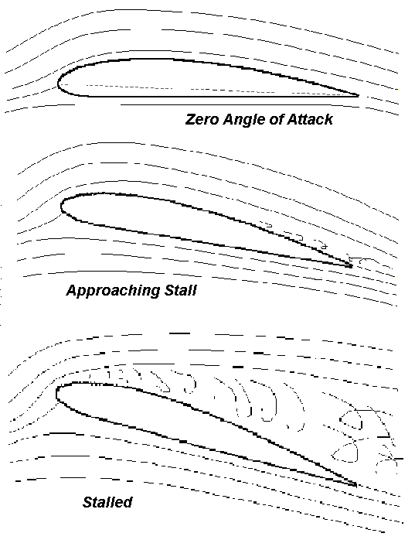
ANGLE OF ATTACK

Slide 14
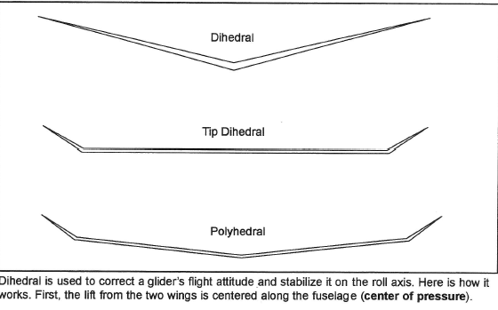
DIHEDRALS

Slide 15
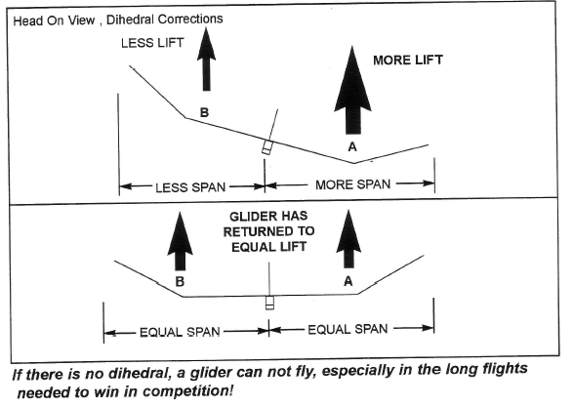
WHY DIHEDRALS?

Slide 16
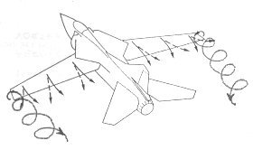
WING VORTEX

Slide 17
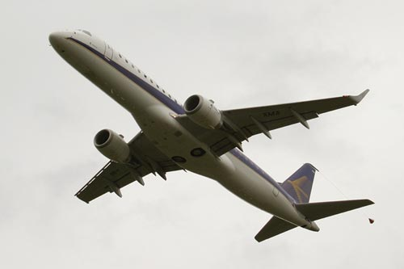
SOLUTION

Slide 18
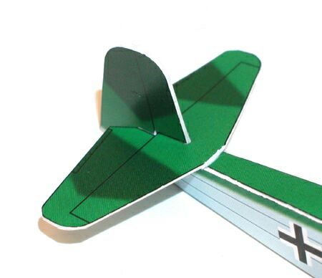
GLIDER TAIL

Slide 19
TAIL FUNCTION
HORIZONTAL STABILIZER-CONTROL PITCH- NOSE UP/NOSE DOWN
VERTICAL STABILIZER- CONTROL YAW- LEFT/RIGHT

Slide 20
STABILIZER SIZES
OUTDOORS-
HORIZONTAL-1/5 AREA OF WING
VERTICAL-1/3 TO 1/2 OF HORIZONTAL
INDOORS-
HORIZONTAL-1/6 TO 1/8 WING AREA
VERTICAL- 1/3 TO ½ OF HORIZONTAL

Slide 21
HINTS
NO SQUARE EDGES.
STABILIZERS SMALL BUT NOT TO THE POINT OF INSTABILITY
CENTER OF GRAVITY OF FINISHED GLIDER IS 1/3 TO ½ FROM THE FRONT EDGE OF THE WING.
TAPERED BOOM.
OUTDOORS USE GLIDERS HEAVIER THAN 10 GRAMS.

Slide 22
MORE HINTS
FUSELAGE LENGTH EQUAL TO OR SLIGHTLY LONGER THAN WINGSPAN
WING LOADING RATIO= GLIDER WEIGHT/WING AREA LOWER IS BETTER.
GLIDE RATIO= DIST./SINK RATE
CIRCULAR FLIGHT PATTERN
USE ‘TOOLS’ and ‘JIGS AND FIXTURES’ FOR DIHEDRALS, ETC.

Slide 23
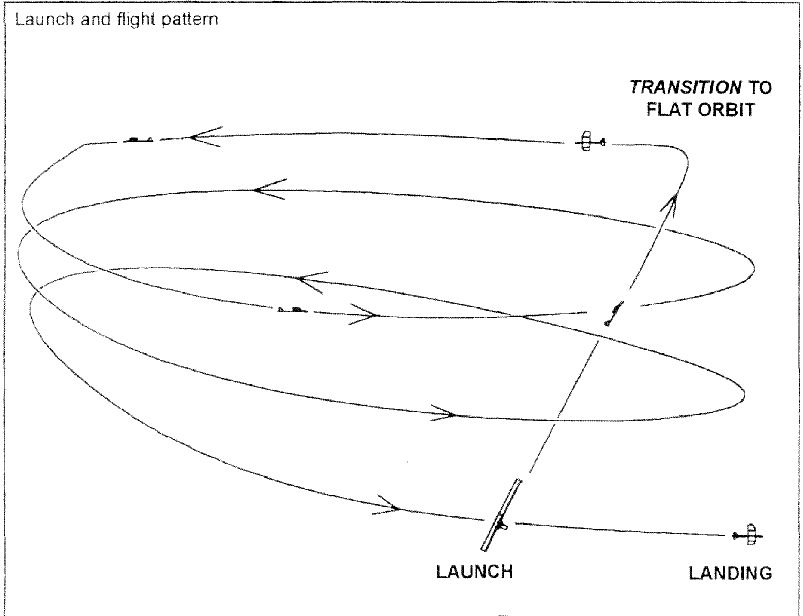
FLIGHT PATH

Slide 24
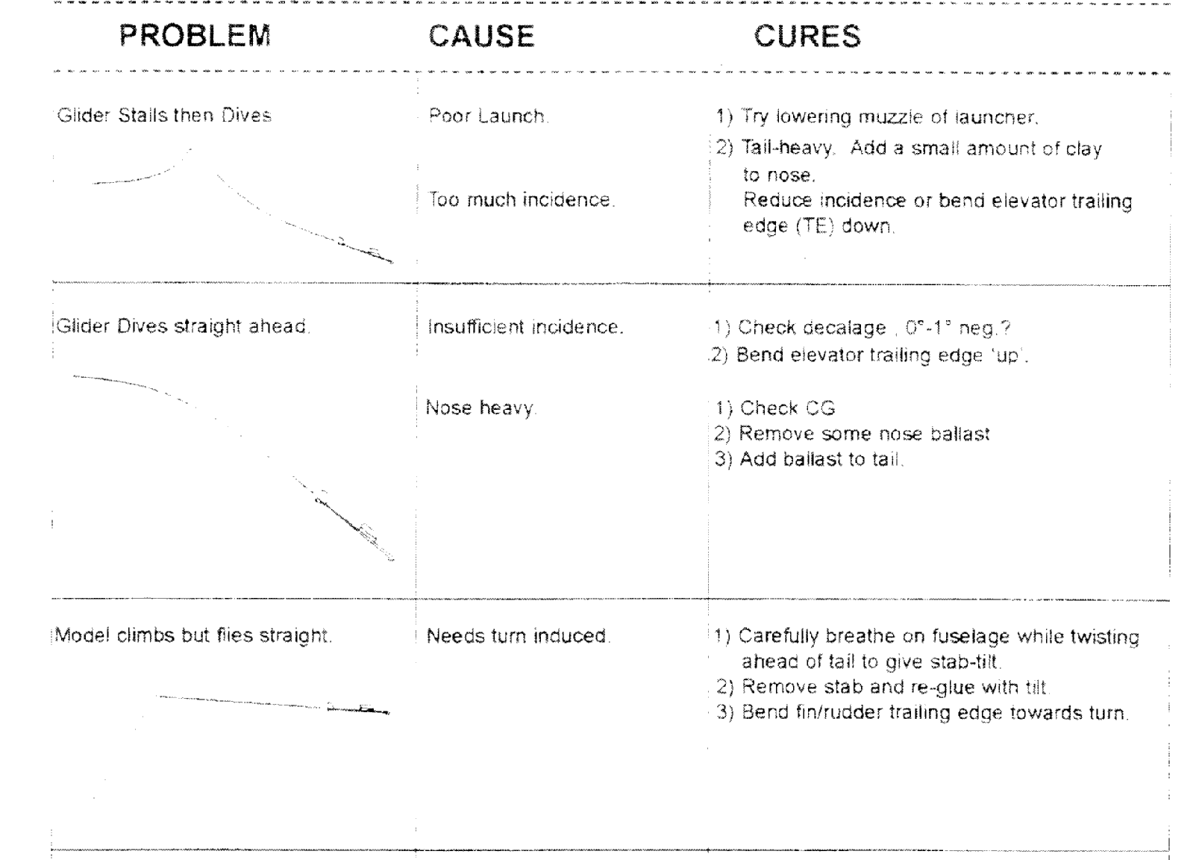
TROUBLE SHOOTING

Slide 25
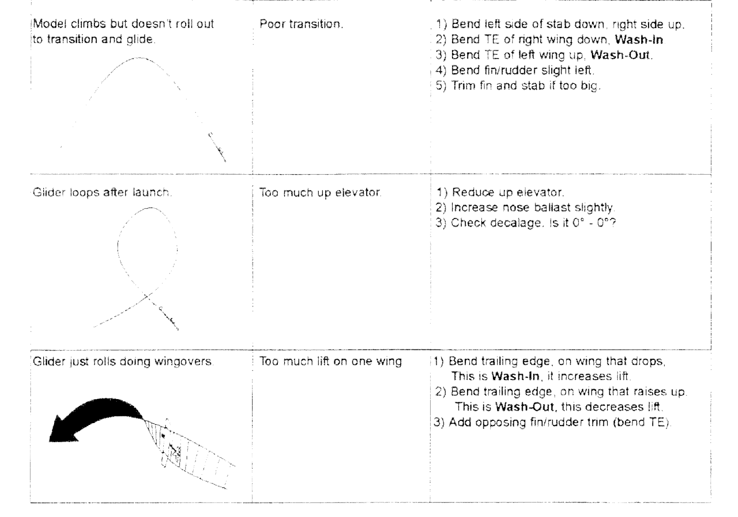
MORE TS

Slide 26
ADDRESS
David Braunstein
dbraunst@csulb.edu

